Slide 1
Real-Time ECG Signal Simulation and Analysis
Name: Youssef Essam
Course: Biomedical Acquisition
Course Code: BMD351(FALL 2024 )
Date: 5-1-2025

Slide 2

Introduction
What is ECG?
Objective of the Project:
ECG (Electrocardiogram) measures the electrical activity of the heart.
It helps in diagnosing heart conditions.
Simulate ECG signals.
Process and analyze the signals to extract the heart rate.

Slide 3
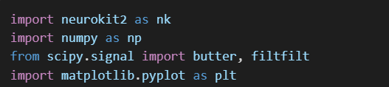
Tools and Libraries
Programming Language: Python
Libraries Used:
NeuroKit2: For ECG simulation and R-peak detection.
Scipy: For signal filtering (Butterworth filter).
Matplotlib: For visualization.
NumPy: For numerical calculations.

Slide 4
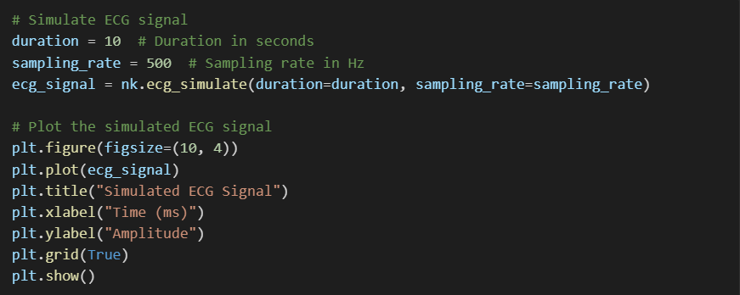
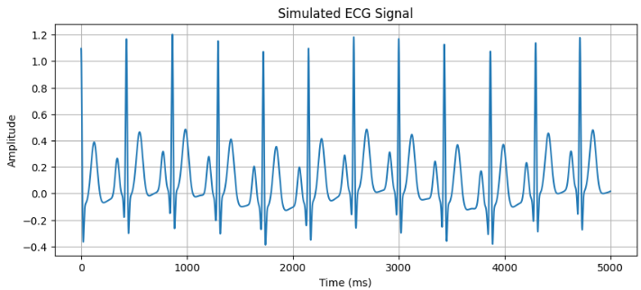
Signal Simulation
Objective: Generate a 10-second ECG signal at 500 Hz sampling rate.

Slide 5
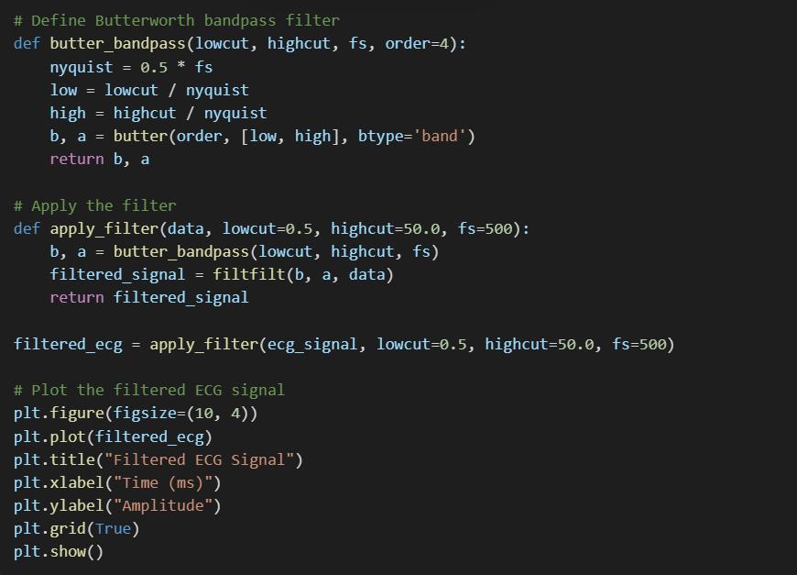
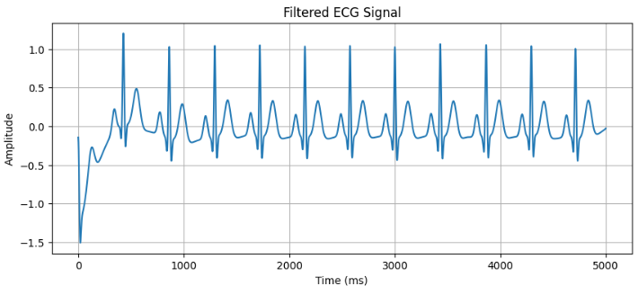
Signal Filtering
Objective: Apply a Butterworth filter to remove noise (0.5-50 Hz).

Slide 6
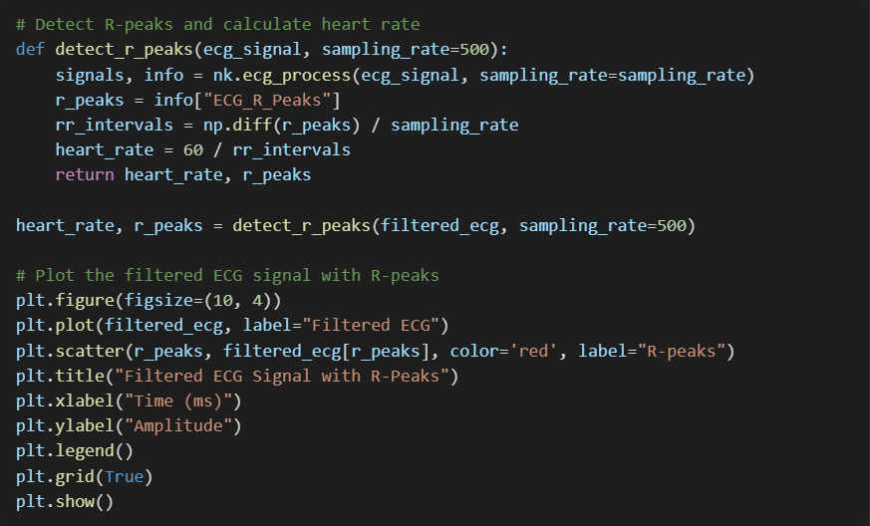
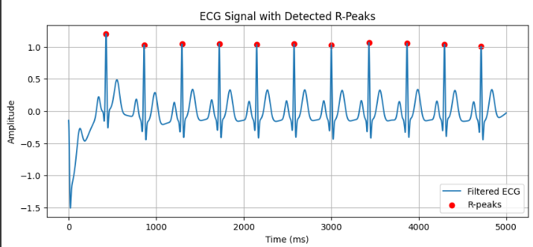
R-Peak Detection
Objective: Detect R-peaks in the filtered signal and calculate heart rate.

Slide 7
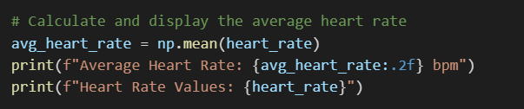
Heart Rate Results
Objective: Calculate the average heart rate.
Output:

Slide 8

Challenges
Difficulties Faced:
Choosing appropriate filter parameters for noise removal.
Validating results without access to real ECG data.
Understanding and processing RR intervals.
Solutions:
Adjusted filter parameters (0.5-50 Hz).
Used NeuroKit2’s built-in functions for validation
.

Slide 9

Applications
Potential Real-World Applications:
Real-time patient monitoring in hospitals.
Development of wearable ECG devices.
Biomedical research for advanced signal processing.

Slide 10
Conclusion
Summary:
Successfully simulated, filtered, and analyzed ECG signals.
Accurately calculated the average heart rate and visualized results.
Future Work:
Integration with real-time hardware for live ECG analysis.
Adding advanced metrics like HRV (Heart Rate Variability).

Slide 11
10 references For Comparison
1-A Real-Time QRS Detection Algorithm Link
2-PhysioBank, PhysioToolkit, and PhysioNet: Components of a New Research Resource for Complex Physiologic Signals Link
3-Open Source ECG Analysis Software Link
4-Signal Processing Methods for Heart Rate Variability Link
5-NeuroKit2: A Python Toolbox for Physiological Signal Processing Link
6-A Wavelet-Based ECG Delineator Link
7-Robust Signal Detection in Multichannel ECGs Link
8-Using Wavelet Transforms for ECG Characterization Link
9-A Comparison of Noise Sensitivity of QRS Detection Algorithms Link
10-A Review on ECG Signal Denoising Techniques Link

Slide 12
Thank You

